Slide 1

Computers as second language speakers and its implications for CFL learning and instruction
Jun Da (笪骏), Ph.D.
CLTA-SIG, 08/07/2021

Slide 2
Note
First presented at BCLTS 2021 in July 2021: https://bclts.org.uk/conference/

Slide 3
Objectives
Argue for viewing computers as second language speakers
Discuss some research and pedagogical challenges for CFL learning and instruction

Slide 4
Outline
Some observations about the use of natural language technologies from the real word and L2 classrooms
Traditional roles of technology and perceptions of its functions in L2 learning and teaching
Arguments for viewing computers as L2 speakers
Implications for L2 learning, teaching, and acquisition research

Slide 5
1. Natural language processing technologies: Some observations

Slide 6

1.1 Some observations: Speech
Video clip
  https://www.bilibili.com/video/BV1aJ411V7Qa?from=search&seid=14802843967754595303
  https://www.bilibili.com/video/BV16y4y1y7mA/?spm_id_from=333.788.recommend_more_video.3
Audio clip

Slide 7
1.2 Some observations: Text
A short story
  1月19日19点42分，我和吴一来到了南瓦凡德共和国，此地山高林密，地形险峻。在七千年前，这里还是一个动物园，后来经过了一场瘟疫，它才变成了今天这个模样。 ……
  http://xiezuoruanjian.com/autowrite.php （自动写 准游记）
The same story transcribed
  1月19日19点42分我和吴亦来到了南瓦凡得共和国此地山高林密地形险峻在7000年前这里还是一个动物园后来经过了一场瘟疫他才变成了今天这个模样
  Google Speech: https://www.google.com/intl/en/chrome/demos/speech.html
The same story recorded
  https://cloud.tencent.com/product/tts

Slide 8
1.2 Some observations: Text (continued)
The same original story
  1月19日19点42分，我和吴一来到了南瓦凡德共和国，此地山高林密，地形险峻。在七千年前，这里还是一个动物园，后来经过了一场瘟疫，它才变成了今天这个模样。 ……
  http://xiezuoruanjian.com/autowrite.php
The same story translated
  At 19: 42 on January 19th, Wu Yi and I arrived in the Republic of South Vavand, where mountains are high and forests are dense and the terrain is steep. Seven thousand years ago, it was still a zoo, but after a plague, it became what it is today.
  https://fanyi.sogou.com

Slide 9
1.3 Some observations: In the classroom
Students use Google Translate to complete homework assignments.
My student dictated his essay assignment.
News flash: Duolingo's new crew of AI tutors will help you learn languages
  https://www.theverge.com/2016/10/6/13188326/duolingo-language-tutor-chatbor-ai-announced
  Will I lose my job to AI?
…

Slide 10
1.4 What do they have in common?
Result of or related to natural language processing technologies!

Slide 11
1.5 Conclusion first
Capable L2 speakers
From assistants to participants in real-world communications
New challenges for L2 teaching and learning

Slide 12
2. The traditional roles and functions of computers, or technology in general

Slide 13
2.1 A functional distinction
Organizing: Used for teaching and learning management
  e.g., Email, learning management systems, social networking apps and services, file sharing services, etc.
Assisting: Used directly to assist language learning (tutor, facilitator, stimuli, resource, tool)
  Software (services)/hardware specifically developed for language learning purposes
    e.g. Rosetta Stone, Pleco, etc.
  General purpose software and hardware adapted for language learning
    e.g., Word processors, email, social networking apps, and smart phones, etc.

Slide 14
2.2 Technology and L2 acquisition
To facilitate and enrich input and opportunities for learning
  Multimedia presentation of character writing
To facilitate output, interaction and feedback among learners as well as their instructors and other language role models
  Social media, the ‘old’ discussion forums, etc.
To facilitate personalized and collaborative learning
  e.g., Google Docs for collaborative writing
  Electronic dictionary/glossing tools, …
To facilitate better understanding of learners’ language and their learning process/strategies
  Learner corpora: e.g., 北语

Slide 15
2.3 References
Frank et al., 2008
Wu, 2016
Da & Zheng, 2018
Liu & Da, 2021

Slide 16
3. Natural language processing and the emerging participatory role of computers as L2 speakers in real-world communications

Slide 17
3.1 Natural language processing (NLP)
Natural language understanding
Natural language generation

Slide 18
3.2 Applications of NLP technologies
Machine translation
Speech technologies
  Automatic speech recognition
  Speech synthesis
Smart input
  Handwriting recognition
  Voice input
  Input suggestions
Information processing
  Document summary, keyword extraction, sentiment analysis
Creative writing
  Text spinners, creative text generators

Slide 19
3.3 Computers as L2 speakers
Computers speak human/natural language at different proficiency levels!

Slide 20
3.3.1 Interpretive: Listening skills
Do computers understand your speech?
  Automatic speech recognition
    E.g., Voice-to-text conversion found in WeChat
  Voice-enabled interface
    E.g., Browser voice-enabled interface, smart speakers, etc.

Slide 21
3.3.2 Presentational: Speaking skills
Can you understand computer-generated or synthesized speech?
  Yes!
Do you accept computer-generated speech?
  Yes, at least for General Z
  c.f., the video clip seen earlier

Slide 22
3.3.3 Interpretive: Reading skills
Can computers read and understand text?
  Yes, to some degree.
  E.g.,
    https://new.qq.com/omn/20210703/20210703A0A7KH00.html
    https://cloud.tencent.com/product/nlp
    Screen capture next page

Slide 23
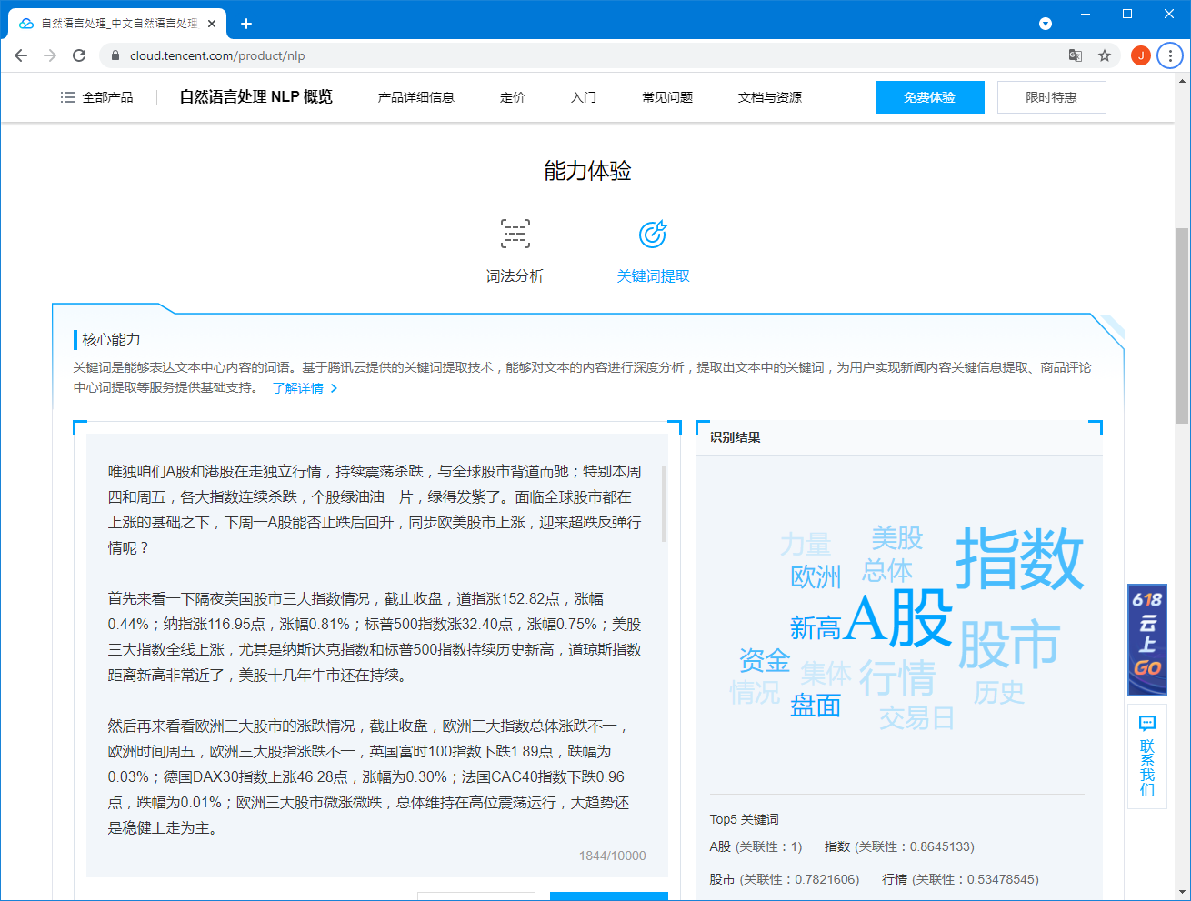

Slide 24
3.3.4 Presentational: Writing skills
A novice writer
  Mostly rewriting of human created content at the phrase/sentence level
  e.g., Text spinners (c.f. https://spinbot.com/)
A more advanced writer
  Creative use of language
  e.g., http://textsummarization.net/text-summarizer
  e.g., https://www.splitbrain.org/services/ots
  e.g., https://medium.com/@andronovhopf/teaching-a-neural-network-to-love-e2e8a082ed99
  e.g. http://xiezuoruanjian.com/autowrite.php
Machine translation as writer?
Very simple introduction to text spinning and automatic text generation:
  https://en.wikipedia.org/wiki/Natural-language_generation
  https://en.wikipedia.org/wiki/Article_spinning

Slide 25
3.3.5 Grammatical competence
Do computers make grammatical errors?
  They are grammatical most of the time, though errors do occur, very often at the global or pragmatic level.
  c.f. the short story and video clip given earlier
C.f., Language-learner language or interlanguage (e.g., Selinker, 1972; Ellis, 1986)
  Permeable: IL at any one stage is not fixed but are open to amendment
  Dynamic: IL changes in stages
  Systematic: A simplified grammar

Slide 26
3.3.6 Authenticity
Is computer-generated language (speech and text) authentic?
What is authenticity?
  c.f. Gilmore (2007)’s summary of various definitions
    ‘real’ language not intended for non-native speakers (Porter & Roberts, 1981, among others)
    the language produced by a real speaker/writer for a real audience, conveying a real message (Morrow, 1977, as cited in Gilmore, 2007)
The answer (next slide)

Slide 27
3.3.6 Authenticity (continued)
If authenticity is defined as (c.f., Gilmore’s summary)
  the language produced by a real speaker/writer for a real audience, conveying a real message
then the answer is YES, (though partially)
  It is not produced by a real (human) speaker/writer, though assistance/coaching comes from the latter.
  However, it is for real communication purposes, e.g., intended for real audiences with a real message.

Slide 28
3.3.7 Interpersonal: Interaction in the real world
For general-purpose use, limited capabilities
  Customer service chatbots
  Voice-enabled interface
Language-specific applications
  Smart input for Chinese characters
    Voice-input
    Handwriting recognition
  Smart suggestions (when, for example, you write email)
Other applications?

Slide 29
3.3.8 Meaning and creative use of language
Technologies | Linguistic form | Meaning | Creativity | Errors
Text-to-speech | Target language: Written => Spoken | (Mostly) no change of meaning | Little creative language use | Could be introduced during conversion
Machine translation | L1 ⬄ L2 | Conversion of the ‘same’ meaning | Some creative language use | Could be introduced during translation
Automatic generated content | Target language: Written and spoken | New meaning | Creative language use in various degrees | (Possible) errors introduced in generation

Slide 30
3.4 Conclusion
Current advancement in natural language processing technologies has turned a dummy computer into a capable second language speaker with subskills at different levels.
Computers have become direct participants in real-world communications with both native and non-native speakers.

Slide 31
4. Research questions and implications for L2 learning and instruction

Slide 32
4.1 At the operational level
Can synthesized speech be used for listening comprehension practice? Do instructors and learners accept such input generated by a computer?
When computers are so good at recognizing real human speech, should we allow students to ‘voice-write’ Chinese characters?
Can my students consult machine translation to search for ideas/prompts in completing their written homework assignments?
Should we allow students to use creative writing software (e.g., text spinner) to assist their writing? Is it plagiarism?
…

Slide 33
4.2 At the pedagogical level
Can a computer, as a (capable) L2 speaker, provide input for L2 learning and serve as a role model for L2 learners?
What kind of effect, whether positive or negative, do computer generated language (both text and speech) have on human L2 learners’ language acquisition?
c.f. Authentic vs non-authentic/modified input
  Authentic input
    Positive evidence (c.f. Long, 2015, among others)
    Cultural information
    c.f. https://www.actfl.org/guiding-principles/use-authentic-texts-language-learning
  Non-authentic/modified input
    What lower level learner are exposed to most of the time (especially in a classroom situation)

Slide 34
4.3 At the curriculum level
As computers become more competent L2 speakers and participate more often in real-world communications, should L2 curriculum be adjusted to include developing human learners’ communicative competence in interacting with computers (or computer-generated language)?
More specifically
  Should we focus more on developing L2 learners’ reading and speaking rather than listening and writing skills?
  Should students be trained to comprehend computers’ accent (if any) and ‘broken’ language?
  Is learning stroke order a necessary part of Chinese character acquisition? Or even further, is learning handwriting characters necessary in the future?
  …

Slide 35
4.4 Conclusion
We need to address these questions as computers become increasingly capable L2 speakers!

Slide 36
References
Da, J., & Zheng, Y. (2018). Technology and the teaching and learning of Chinese as a foreign language. In C. Ke. (Ed.), The Routledge handbook of Chinese second language acquisition (pp. 432-447). New York: Routledge.
Ellis, R. 1986. Understanding second language acquisition (pp. 42-74). Oxford University Press.
Frank, V., Golonka, E., Bowles, A., Becker, E., Freynick, S., & Richardson, D. (2008). Optimal foreign language learning: The role of technology. College Park, MD: Center for Advanced Study of Language at the University of Maryland. https://lingua.mtsu.edu/academic/bclts2021/Frank08_RoleofTechnology.pdf (local cached copy)
Gilmore, A. (2007). Authentic materials and authenticity in foreign language learning. Language Teaching, 40(2), 97-118.
Liu, S. J., & Da, J. (2021). Technology in Chinese language teaching. To appear in Z. D. Ye, (Ed.), The Palgrave handbook of Chinese language studies. London: Palgrave Macmillan.
Selinker, L. 1972. Interlanguage. International Review of Applied Linguistics. 10. 209-231.
Wu, Y. (2016). Technology in CFL education. in J. Ruan, J. Zhang & C. B. Leung (Eds.), Chinese language education in the United States (pp. 97-122). New York, NY: Springer.

